Slide 1
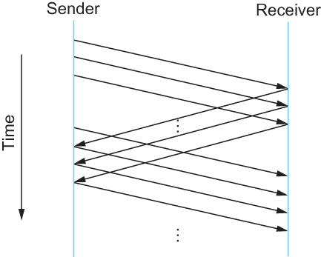
Sliding Window Protocol
Timeline for Sliding Window Protocol

Slide 2
Sliding Window Protocol
Sender assigns a sequence number denoted as SeqNum to each frame.
  Assume it can grow infinitely large
Sender maintains three variables
  Sending Window Size (SWS)
    Upper bound on the number of outstanding (unacknowledged) frames that the sender can transmit
  Last Acknowledgement Received (LAR)
    Sequence number of the last acknowledgement received
  Last Frame Sent (LFS)
    Sequence number of the last frame sent
Notes:
The University of Adelaide, School of Computer Science
Chapter 2 — Instructions: Language of the Computer

Slide 3
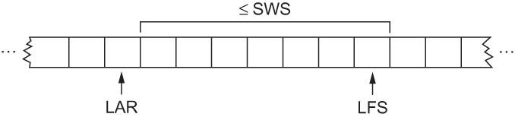
Sliding Window Protocol
Sender also maintains the following invariant
  LFS – LAR ≤ SWS
Sliding Window on Sender
Notes:
The University of Adelaide, School of Computer Science
Chapter 2 — Instructions: Language of the Computer

Slide 4
Sliding Window Protocol
When an acknowledgement arrives
  the sender moves LAR to right, thereby allowing the sender to transmit another frame
Also the sender associates a timer with each frame it transmits
  It retransmits the frame if the timer expires before the ACK is received
Note that the sender has to be willing to buffer up to SWS frames
  WHY?
Notes:
The University of Adelaide, School of Computer Science
Chapter 2 — Instructions: Language of the Computer

Slide 5
Sliding Window Protocol
Receiver maintains three variables
  Receiving Window Size (RWS)
    Upper bound on the number of out-of-order frames that the receiver is willing to accept
  Largest Acceptable Frame (LAF)
    Sequence number of the largest acceptable frame
  Last Frame Received (LFR)
    Sequence number of the last frame received
Notes:
The University of Adelaide, School of Computer Science
Chapter 2 — Instructions: Language of the Computer

Slide 6
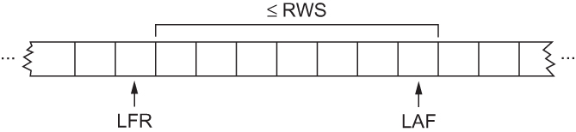
Sliding Window Protocol
Receiver also maintains the following invariant
  LAF – LFR ≤ RWS
Sliding Window on Receiver
Notes:
The University of Adelaide, School of Computer Science
Chapter 2 — Instructions: Language of the Computer

Slide 7
Sliding Window Protocol
When a frame with sequence number SeqNum arrives, what does the receiver do?
  If SeqNum ≤ LFR or SeqNum > LAF
    Discard it (the frame is outside the receiver window)
  If LFR < SeqNum ≤ LAF
    Accept it
    Now the receiver needs to decide whether or not to send an ACK
Notes:
The University of Adelaide, School of Computer Science
Chapter 2 — Instructions: Language of the Computer

Slide 8
Sliding Window Protocol
  Let SeqNumToAck
    Denote the largest sequence number not yet acknowledged, such that all frames with sequence number less than or equal to SeqNumToAck have been received
  The receiver acknowledges the receipt of SeqNumToAck even if high-numbered packets have been received
    This acknowledgement is said to be cumulative.
  The receiver then sets
    LFR = SeqNumToAck and adjusts
    LAF = LFR + RWS
Notes:
The University of Adelaide, School of Computer Science
Chapter 2 — Instructions: Language of the Computer

Slide 9
Sliding Window Protocol
For example, suppose LFR = 5 and RWS = 4
(i.e. the last ACK that the receiver sent was for seq. no. 5)
LAF = 9
If frames 7 and 8 arrive, they will be buffered because they are within the receiver window
But no ACK will be sent since frame 6 is yet to arrive
Frames 7 and 8 are out of order
Frame 6 arrives (it is late because it was lost first time and had to be retransmitted)
Now Receiver Acknowledges Frame 8
and bumps LFR to 8
and LAF to 12
Notes:
The University of Adelaide, School of Computer Science
Chapter 2 — Instructions: Language of the Computer

Slide 10
Issues with Sliding Window Protocol
When timeout occurs, the amount of data in transit decreases
  Since the sender is unable to advance its window
When the packet loss occurs, this scheme is no longer keeping the pipe full
  The longer it takes to notice that a packet loss has occurred, the more severe the problem becomes
How to improve this
  Negative Acknowledgement (NAK)
  Additional Acknowledgement
  Selective Acknowledgement
Notes:
The University of Adelaide, School of Computer Science
Chapter 2 — Instructions: Language of the Computer

Slide 11
Issues with Sliding Window Protocol
Negative Acknowledgement (NAK)
  Receiver sends NAK for frame 6 when frame 7 arrive (in the previous example)
    However this is unnecessary since sender’s timeout mechanism will be sufficient to catch the situation
Additional Acknowledgement
  Receiver sends additional ACK for frame 5 when frame 7 arrives
    Sender uses duplicate ACK as a clue for frame loss
Selective Acknowledgement
  Receiver will acknowledge exactly those frames it has received, rather than the highest number frames
    Receiver will acknowledge frames 7 and 8
    Sender knows frame 6 is lost
    Sender can keep the pipe full (additional complexity)
Notes:
The University of Adelaide, School of Computer Science
Chapter 2 — Instructions: Language of the Computer

Slide 12
Issues with Sliding Window Protocol
How to select the window size
  SWS is easy to compute
    Delay × Bandwidth
  RWS can be anything
    Two common setting
        RWS = 1
        No buffer at the receiver for frames that arrive out of order
        RWS = SWS
        The receiver can buffer frames that the sender transmits
        It does not make any sense to keep RWS > SWS
        WHY?
Notes:
The University of Adelaide, School of Computer Science
Chapter 2 — Instructions: Language of the Computer

Slide 13
Issues with Sliding Window Protocol
Finite Sequence Number
  Frame sequence number is specified in the header field
    Finite size
        3 bit: eight possible sequence number: 0, 1, 2, 3, 4, 5, 6, 7
    It is necessary to wrap around
Notes:
The University of Adelaide, School of Computer Science
Chapter 2 — Instructions: Language of the Computer

Slide 14
Issues with Sliding Window Protocol
How to distinguish between different incarnations of the same sequence number?
  Number of possible sequence number must be larger than the number of outstanding frames allowed
    Stop and Wait: One outstanding frame
        2 distinct sequence number (0 and 1)
    Let MaxSeqNum be the number of available sequence numbers
    SWS + 1 ≤ MaxSeqNum
      Is this sufficient?
Notes:
The University of Adelaide, School of Computer Science
Chapter 2 — Instructions: Language of the Computer

Slide 15
Issues with Sliding Window Protocol
SWS + 1 ≤ MaxSeqNum
      Is this sufficient?
      Depends on RWS
      If RWS = 1, then sufficient
      If RWS = SWS, then not good enough
For example, we have eight sequence numbers
0, 1, 2, 3, 4, 5, 6, 7
RWS = SWS = 7
Sender sends 0, 1, …, 6
Receiver receives 0, 1, … ,6
Receiver acknowledges 0, 1, …, 6
ACK (0, 1, …, 6) are lost
Sender retransmits 0, 1, …, 6
Receiver is expecting 7, 0, …., 5
Notes:
The University of Adelaide, School of Computer Science
Chapter 2 — Instructions: Language of the Computer

Slide 16
Issues with Sliding Window Protocol
To avoid this,
If RWS = SWS
SWS < (MaxSeqNum + 1)/2
Notes:
The University of Adelaide, School of Computer Science
Chapter 2 — Instructions: Language of the Computer

Slide 17
Issues with Sliding Window Protocol
Serves three different roles
  Reliable
  Preserve the order
    Each frame has a sequence number
    The receiver makes sure that it does not pass a frame up to the next higher-level protocol until it has already passed up all frames with a smaller sequence number
  Frame control
    Receiver is able to throttle the sender
      Keeps the sender from overrunning the receiver
        From transmitting more data than the receiver is able to process
Notes:
The University of Adelaide, School of Computer Science
Chapter 2 — Instructions: Language of the Computer

